Slide 1
Chapter 8
Intrusion Detection

Slide 2
Classes of Intruders – Cyber Criminals
Individuals or members of an organized crime group with a goal of financial reward
Their activities may include:
Identity theft
Theft of financial credentials
Corporate espionage
Data theft
Data ransoming
Typically they are young, often Eastern European, Russian, or southeast Asian hackers, who do business on the Web
They meet in underground forums to trade tips and data and coordinate attacks

Slide 3
Classes of Intruders – Activists
Are either individuals, usually working as insiders, or members of a larger group of outsider attackers, who are motivated by social or political causes
Also know as hacktivists
Skill level is often quite low
Aim of their attacks is often to promote and publicize their
cause typically through:
Website defacement
Denial of service attacks
Theft and distribution of data that results in negative publicity or compromise of their targets

Slide 4

Classes of Intruders – State-Sponsored Organizations
Groups of hackers sponsored by governments to conduct espionage or sabotage activities
Also known as Advanced Persistent Threats (APTs) due to the covert nature and persistence over extended periods involved with any attacks in this class
Widespread nature and scope of these activities by a wide range of countries from China to the USA, UK, and their intelligence allies

Slide 5
Classes of Intruders – Others
Hackers with motivations other than those previously listed
Include classic hackers or crackers who are motivated by
technical challenge or by peer-group esteem and reputation
Many of those responsible for discovering new categories of buffer overflow vulnerabilities could be regarded as members of this class
Given the wide availability of attack toolkits, there is a pool of “hobby hackers” using them to explore system and network security

Slide 6
Intruder Skill Levels – Apprentice
Hackers with minimal technical skill who primarily use
existing attack toolkits
They likely comprise the largest number of attackers, including many criminal and activist attackers
Given their use of existing known tools, these attackers are the
easiest to defend against
Also known as “script-kiddies” due to their use of existing scripts (tools)

Slide 7
Intruder Skill Levels – Journeyman
Hackers with sufficient technical skills to modify and extend attack toolkits to use newly discovered, or purchased, vulnerabilities
They may be able to locate new vulnerabilities to exploit that are similar to some already known
Hackers with such skills are likely found in all intruder classes
Adapt tools for use by others

Slide 8
Intruder Skill Levels – Master
Hackers with high-level technical skills capable of discovering brand new categories of vulnerabilities
Write new powerful attack toolkits
Some of the better known classical hackers are of this level
Some are employed by state-sponsored organizations
Defending against these attacks is of the highest difficulty

Slide 9
Examples of Intrusion
Remote root compromise
Web server defacement
Guessing/cracking passwords
Copying databases containing credit
Viewing sensitive data without authorization
Running a packet sniffer
Distributing pirated software
Using an unsecured modem to access internal
Impersonating an executive to get information
Using an unattended workstation
card numbers
network

Slide 10


Intruder Behavior
Target acquisition and information gathering
Privilege
escalation
Target acquisition
and information
gathering
Initial access
Privilege
escalation
Information gathering or system exploit
Covering tracks
Information
gathering or system exploit
Maintaining access
Covering tracks

Slide 11
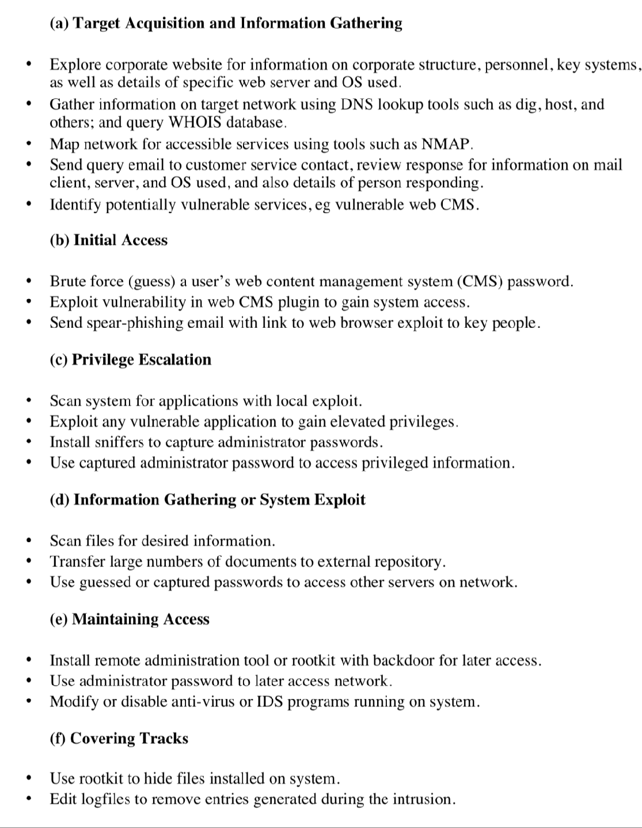
Table 8.1
Examples of Intruder Behavior
(Table can be found on pages 255-256 in the textbook.)

Slide 12
Definitions
Security Intrusion:
Unauthorized act of bypassing the security mechanisms of a system
Intrusion Detection:
A hardware or software function that gathers and analyzes information from various areas within a computer or a network to identify possible security intrusions

Slide 13


Intrusion Detection System (IDS)
Host-based IDS (HIDS)
Monitors the characteristics of a single host for suspicious activity
Network-based IDS
(NIDS)
Monitors network traffic and analyzes network, transport, and application protocols to identify suspicious activity
Distributed or hybrid IDS
Combines information from a number of sensors, often both host and network based, in a central analyzer that is able to better identify and respond to intrusion activity
Comprises three logical components:
Sensors - collect data
Analyzers - determine if intrusion has occurred
User interface - view output or control system behavior

Slide 14
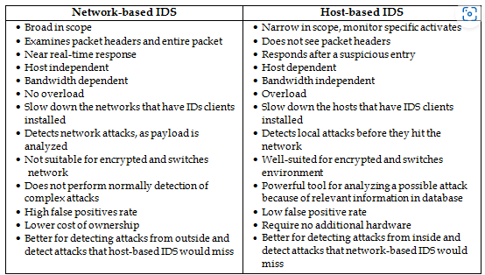

Slide 15
IDS Requirements
Run continually
Be fault tolerant
Resist subversion
Run continually
Be fault tolerant
Resist subversion
Impose a minimal overhead on system
Configured according to system security policies
Adapt to changes in systems and users
Impose a minimal overhead on system
Configured according to system security policies
Adapt to changes in systems and users
Scale to monitor large numbers of systems
Provide graceful degradation of service
Allow dynamic reconfiguration
Scale to monitor large numbers of systems
Provide graceful degradation of service
Allow dynamic reconfiguration

Slide 16
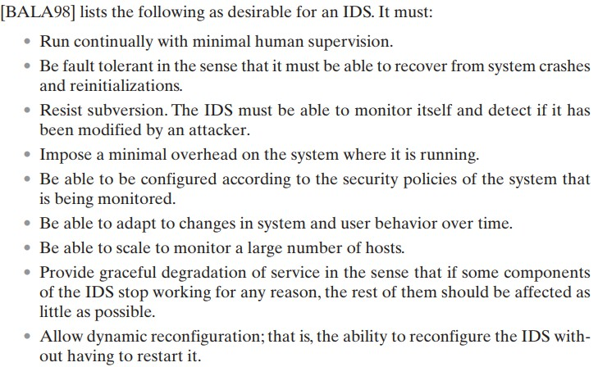

Slide 17
Analysis Approaches
Signature/Heuristic detection
Anomaly detection
Involves the collection of data relating to the behavior of legitimate users over a period of time
Current observed behavior is analyzed to determine whether this behavior is that of a legitimate user or that of an intruder
Uses a set of known malicious data patterns or attack rules that are compared with current behavior
Also known as misuse
detection
Can only identify known attacks for which it has patterns or rules

Slide 18

Anomaly Detection
A variety of classification approaches are used:
Statistical
Knowledge based
Machine-learning
Analysis of the observed behavior using univariate, multivariate, or time-series models of observed metrics
Approaches use an expert system that classifies observed behavior according to a set of rules that model legitimate behavior
Approaches automatically determine a suitable classification model from the training data using data mining techniques

Slide 19



Signature or Heuristic Detection
Rule-based heuristic identification
Signature approaches
Match a large collection of known patterns of malicious data against data stored on a system or in transit over a network
Involves the use of rules for identifying known penetrations or penetrations that would exploit known weaknesses
The signatures need to be large enough to minimize the false alarm rate, while still detecting a sufficiently large fraction of malicious data
Rules can also be defined that identify suspicious behavior, even when the behavior is within the bounds of established patterns of usage
Widely used in anti-virus products, network traffic scanning proxies, and in NIDS
Typically rules used are specific
SNORT is an example of a rule-based NIDS

Slide 20
Host-Based Intrusion Detection (HIDS)
Adds a specialized layer of security software to vulnerable or sensitive systems
Can use either anomaly or signature and heuristic approaches
Monitors activity to detect suspicious behavior
Primary purpose is to detect intrusions, log suspicious events, and send alerts
Can detect both external and internal intrusions

Slide 21

Data Sources and Sensors
Common data sources include:
System call traces
Audit (log file) records
File integrity checksums
Registry access
A fundamental component of intrusion detection is the sensor that collects data

Slide 22
Table 8.2
(a) Ubuntu Linux System Calls
accept, access, acct, adjtime, aiocancel, aioread, aiowait, aiowrite, alarm, async_daemon, auditsys, bind, chdir, chmod, chown, chroot, close, connect, creat, dup, dup2, execv, execve, exit, exportfs, fchdir, fchmod, fchown, fchroot, fcntl, flock, fork, fpathconf, fstat, fstat, fstatfs, fsync, ftime, ftruncate, getdents, getdirentries, getdomainname, getdopt, getdtablesize, getfh, getgid, getgroups, gethostid, gethostname, getitimer, getmsg, getpagesize, getpeername, getpgrp, getpid, getpriority, getrlimit, getrusage, getsockname, getsockopt, gettimeofday, getuid, gtty, ioctl, kill, killpg, link, listen, lseek, lstat, madvise, mctl, mincore, mkdir, mknod, mmap, mount, mount, mprotect, mpxchan, msgsys, msync, munmap, nfs_mount, nfssvc, nice, open, pathconf, pause, pcfs_mount, phys, pipe, poll, profil, ptrace, putmsg, quota, quotactl, read, readlink, readv, reboot, recv, recvfrom, recvmsg, rename, resuba, rfssys, rmdir, sbreak, sbrk, select, semsys, send, sendmsg, sendto, setdomainname, setdopt, setgid, setgroups, sethostid, sethostname, setitimer, setpgid, setpgrp, setpgrp, setpriority, setquota, setregid, setreuid, setrlimit, setsid, setsockopt, settimeofday, setuid, shmsys, shutdown, sigblock, sigpause, sigpending, sigsetmask, sigstack, sigsys, sigvec, socket, socketaddr, socketpair, sstk, stat, stat, statfs, stime, stty, swapon, symlink, sync, sysconf, time, times, truncate, umask, umount, uname, unlink, unmount, ustat, utime, utimes, vadvise, vfork, vhangup, vlimit, vpixsys, vread, vtimes, vtrace, vwrite, wait, wait3, wait4, write, writev
Linux System Calls and Windows DLLs
Monitored
(b) Key Windows DLLs and Executables
comctl32 kernel32 msvcpp msvcrt mswsock ntdll ntoskrnl user32 ws2_32
(Table can be found on
page 264 in the textbook)

Slide 23
LAN Monitor
Host
Host
Agent module
Router
Internet
Central Manager
Manager module
Figure 8.2 Architecture for Distributed Intrusion Detection

Slide 24
Filter for security interest
OS audit function
OS audit
Reformat function
information
Host audit record (HAR)
Logic module
Analysis module
Alerts
Central manager
Notable activity;
Query/
Signatures; Noteworthy sessions
response
Templates
Modifications
Figure 8.3 Agent Architecture

Slide 25

Network-Based IDS (NIDS)
Monitors traffic at selected
points on a network
May examine network, transport, and/or application-level protocol activity
Examines traffic packet by packet in real or close to real time
May examine network, transport, and/or application-level protocol activity
Monitors traffic at selected
points on a network
Comprised of a number of sensors, one or more servers for NIDS management functions, and one or more management consoles for the human interface
Analysis of traffic patterns may be done at the sensor, the management server or a combination of the two
Comprised of a number of sensors, one or more servers for NIDS management functions, and one or more management consoles for the human interface
Analysis of traffic patterns may be done at the sensor, the management server or a combination of the two

Slide 26



Network traffic
Monitoring interface (no IP, promiscuous mode)
NIDS
sensor
Management interface (with IP)
Figure 8.4 Passive NIDS Sensor

Slide 27


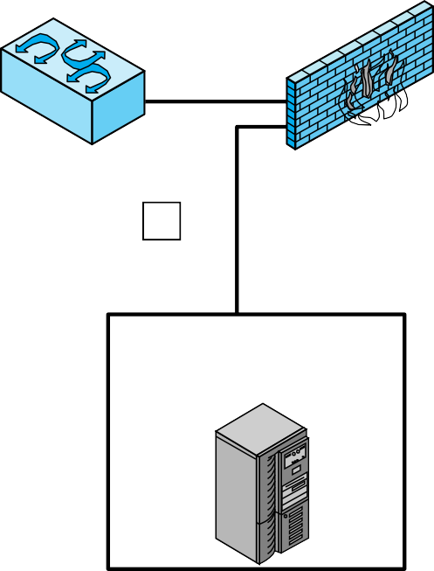



Internet
internal server and data resource networks
3
LAN switch or router
internal firewall
2
LAN switch or router
external firewall
1
workstation networks
service network (Web, Mail, DNS, etc.)
4
LAN switch or router
internal firewall
Figure 8.5
Example of NIDS Sensor Deployment

Slide 28
Intrusion Detection Techniques
Attacks suitable for Signature detection
Application layer reconnaissance and attacks
Transport layer reconnaissance
and attacks
Network layer reconnaissance and attacks
Unexpected application
services
Policy violations
Attacks suitable for Anomaly detection
Denial-of-service (DoS) attacks
Scanning
Worms

Slide 29
Stateful Protocol Analysis (SPA)
Subset of anomaly detection that compares observed network traffic against predetermined universal vendor supplied profiles of benign protocol traffic
This distinguishes it from anomaly techniques trained with
organization specific traffic protocols
Understands and tracks network, transport, and application protocol states to ensure they progress as expected
A key disadvantage is the high resource use it requires

Slide 30
Logging of Alerts
Typical information logged by a NIDS sensor includes:
Timestamp
Connection or session ID
Event or alert type
Rating
Network, transport, and application layer protocols
Source and destination IP addresses
Source and destination TCP or UDP ports, or ICMP types and codes
Number of bytes transmitted over the connection
Decoded payload data, such as application requests and responses
State-related information

Slide 31
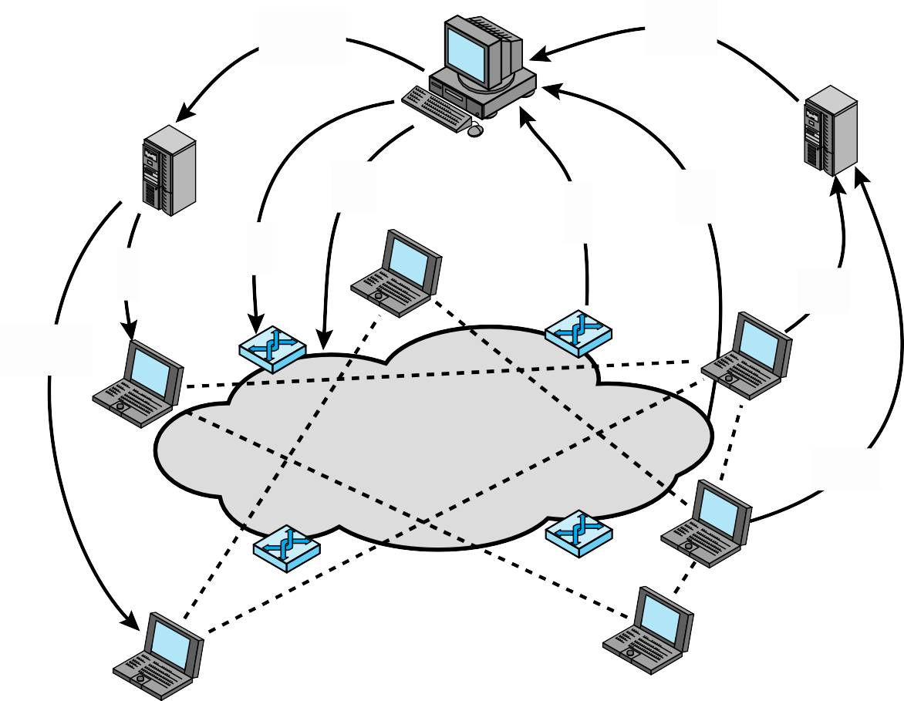
Adaptive feedback based policies
Platform policies
Summary events
Collaborative policies
Network policies
DDI
events
PEP
events
Platform policies
Platform events
Platform policies
Distributed detection and inference
Platform events
gossip
PEP = policy enforcement point
DDI = distributed detection and infer ence
Figure 8.6 Overall Architecture of an Autonomic Enterprise Security System

Slide 32
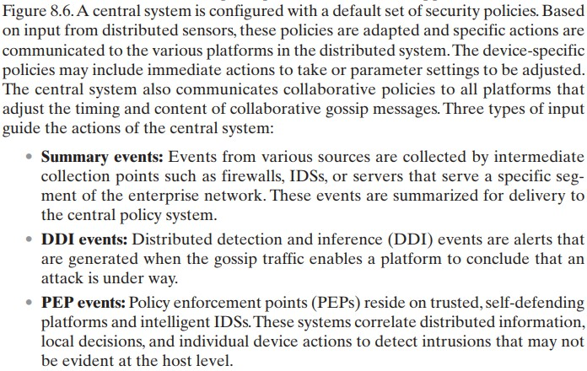

Slide 33
Summary
Host-based intrusion detection
Data sources and sensors
Anomaly HIDS
Signature or heuristic HIDS
Distributed HIDS
Network-based intrusion detection
Types of network sensors
NIDS sensor deployment
Intrusion detection techniques
Logging of alerts
Example system: Snort
Snort architecture
Snort rules
Intruders
Intruder behavior
Intrusion detection
Basic principles
The base-rate fallacy
Requirements
Analysis approaches
Anomaly detection
Signature or heuristic detection
Distributed or hybrid intrusion detection
Intrusion detection exchange
format
Honeypots

